Slide 1
NationaliTeas
Project Management Strategies

Slide 2
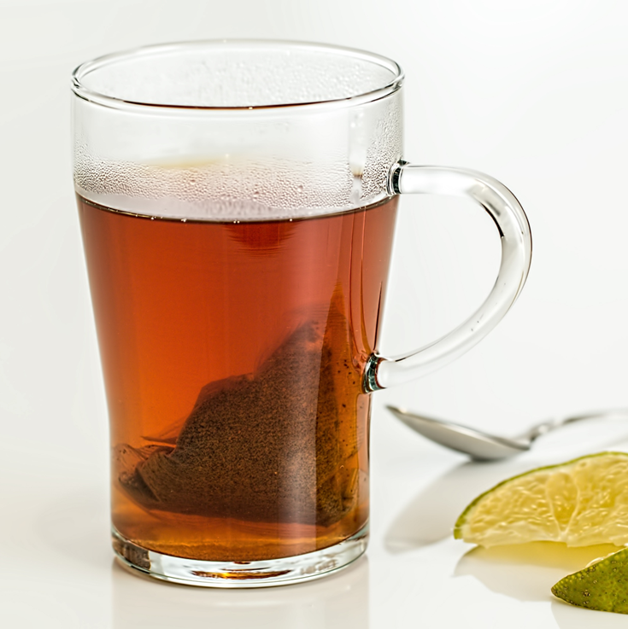
NationaliTeas Mission
“Make the world more awake through rejuvenating and refreshing beverages and sustainable practices that uplift workers, communities, and souls.”
Notes:
The basis of everything we do is summed up in our mission. Our sustainability and lean operations will contribute to meeting our obejctives.

Slide 3
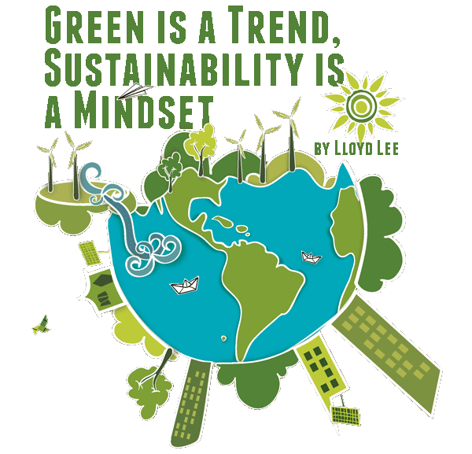
Business Objectives
Analyze workflow processes for improvements to increase the company’s overall sustainability metrics
Analyze workflow processes for ways to reduce waste or unnecessary steps that don’t add value to our product’s end users
Analyze workflow processes to improve the chances the organization is approved as a Certified B Corporation
ThePhoto by PhotoAuthor is licensed under CCYYSA.
Notes:
Throughout this presentation, I will show you ways I think we can get on the path toward meeting these objectives which include workflow processes, reduction of waste, and working towards becoming a B Corp.

Slide 4
Goal
Revise current workflow and sustainability
We will do this by focusing on two main principles:
Sustainability: Resources are finite and should be used with a view of long-term priorities and consequences of our actions.
Lean Manufacturing: Productivity is maximized while minimizing waste in the manufacturing process, anything that does not add value.
ThePhoto by PhotoAuthor is licensed under CCYYSA.
Notes:
We are focusing on sustainability and lean manufacturing for our goals. Sustainability will lead to goodwill toward our employees, the community, and the environment; and lean manufacturing will be geared toward our maximizing profits while not harming people or the planet (Soomo, 2020).

Slide 5
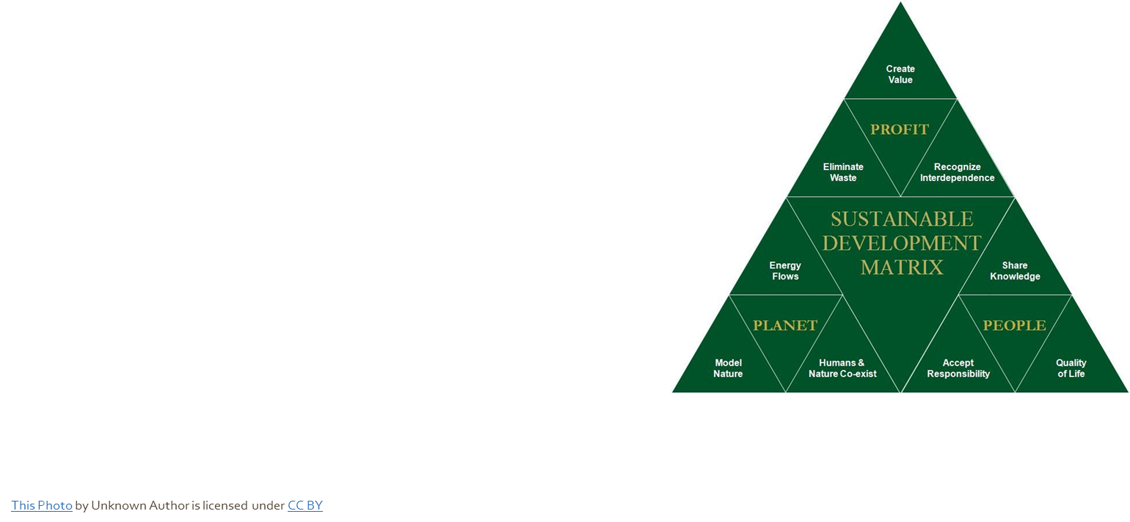
Sustainability
Sustainable practices affect 3 main areas:
People: Employee well-being and satisfaction
Planet: Environmental sustainability
Profit: Economic viability and growth
Notes:
As mentioned in the last slide, the priorities of sustainability are people, planet, and profit. When employees are satisfied and the company’s waste is reduced, it provides for economic viability and growth. The next few slides focus on the sustainability in our operations.

Slide 6
Sustainability – Farm
Reuse 50 kg bags at the farm
Full bags of tea delivered to processing
Drivers pick up empty bags to return
Recycle at end of useful life
Monitor water usage
Implement rain collection for reuse in watering the crops.
Notes:
In the farming stage step two, the 50 kg bags should be reused and recycled at the end of its useful life. Once the bags are delivered to processing and emptied on the pans and troughs, the bags can be sent back to the farm thereby reducing waste and demonstrating a positive environmental impact. Additionally, reclaiming rainwater will reduce our impact on natural resources by conserving water.
By having scales at the farm and packing the bags on scales, it would alleviate the processing department of the first step of weighing the bags upon arrival. This will remove a step from processing and combine the packing of leaves and weighing with no extra motion needed which is also a part of lean manufacturing (Soomo, 2020).

Slide 7
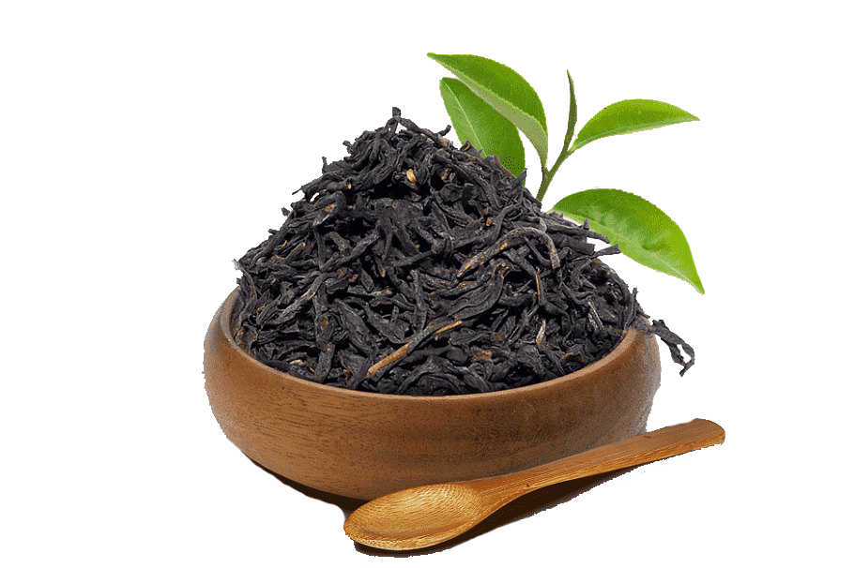
Sustainability – Processing
Are we using sustainable practices in
disposing of defective leaves?
Tea leaves can be used as fertilizer, free of chemicals, through composting (Kimmerer, n.d.).
Repurpose as aromatic sachets
Possibly for sale in our tea stores or as free gifts with purchase.
Are we monitoring water usage?
Water can be reclaimed through rain collection to water the crops
72% of the fresh water used globally is for agriculture so it is imperative to our conserve water (Ragany et al., 2023).
Are we reusing the farm packing bags?
They can be reused or recycled at end of useful life.
Are we optimizing tray usage?
We are using two pans for drying. Can we cut that to one?
ThePhoto by PhotoAuthor is licensed under CCYYSA.
Notes:
We throw away our poor-quality leaves but there are ways to repurpose them. Whether fresh or used leaves, they can be used as fertilizer in our crops. In this scenario, we could promote our farm as organic and with water reclamation, we are on our way to a more sustainable farm.
One of the benefits of these environmental initiatives is qualifying for incentives or grants from the government for research and development to develop more sustainable practices. Should we at some point in the future want to take it further, there are subsidies for solar and other renewable energy sources. For instance, the National Institute of Food and Agriculture (NIFA) has national programs to fund research with competitive grants and professional development programs (NIFA, n.d.).

Slide 8
Sustainability – Packaging and Shipping
Current packaging:
Paper packets
Cardboard boxes
Plastic wrap
8 million tons of plastic are dumped in the ocean each year which threatens wildlife, changes ecosystems and presents health risks (Supply Chain Solutions Center, n.d.).
Our packaging should be environmentally friendly such as sustainable packaging made of 100% recyclable materials.
The foil packaging suggested is not recommended because foil is not biodegradable, can take hundreds of years to decompose, and is also more expensive (PrintOnPack.com. n.d.).
Notes:
This is how we currently package our products. Our sustainability initiatives make an effort to reduce our carbon footprint and conserve natural resources while reducing waste. Specifically, the initiatives address sustainable packaging made of 100% recyclable material. This not only meets our goal for sustainability, but also saves on waste disposal at the consumer level.
Hasbro is a good example of sustainability in the supply chain specific to packaging. They worked with Amazon in their “frustration free packaging” by using 100% recyclable materials and they found it reduced waste (Supply Chain Solutions Center, n.d.).

Slide 9
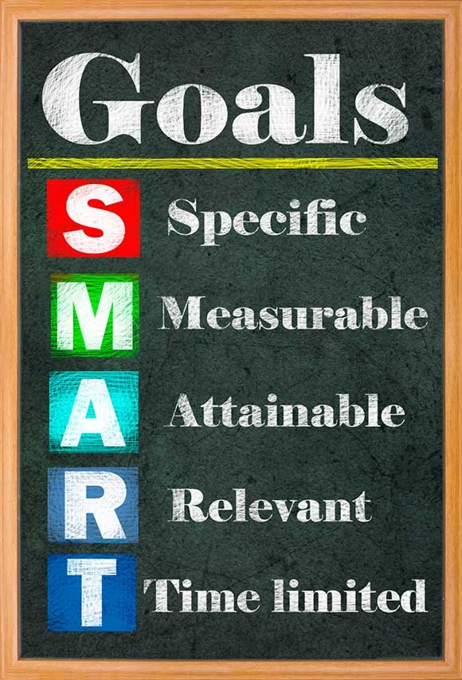
In reviewing the process flowchart for NationaliTeas, there are process steps that can be removed to increase efficiency and reduce waste.
Lean Manufacturing
Notes:
A benefit of lean manufacturing for both the company and employees could be increased production where employees are optimized for efficiency thereby increasing profits for the company while providing stable employment for employees and avoiding layoffs (Soomo, 2020).

Slide 10
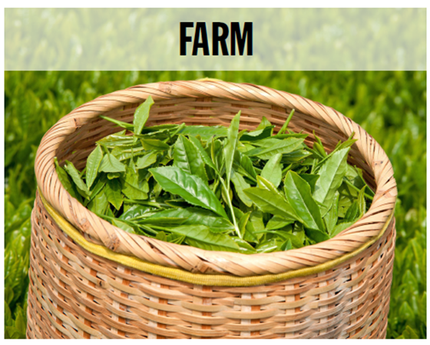
Lean Manufacturing - Farm
Our farm is operating efficiently, and no changes are needed in the process
One step we can add without affecting efficiency is to pack bags while on the scale.
Benefits:
Ensure consistent inventory planning and product availability
Save time that can be used to pack more bags quicker
Drawback:
None because we already have the scales and we are not adding additional steps to the process.
Notes:
Given there are only three steps in the farm process, that area is operating efficiently but we can improve by getting exact weights of the bags of tea by combining it with the packing of the bags on scales. We should also monitor our use of water at the farm and make sure we are implementing water collection from rain for reuse.

Slide 11
Updated Workflow at the Farm
Workers Pick tea leaves
Put leaves in 50 kg bags on scale
Bags moved to Processing
New process of packing bags on the scale
Notes:
The process flow shows that the leaves are packed in 50 kg bags. Do we know that the bags actually weigh 50 kg when they leave the farm? The bags can be placed on the scale while being filled to ensure bag weights are consistent. This also allows us to remove a step in the processing stage while not adding any more steps.

Slide 12
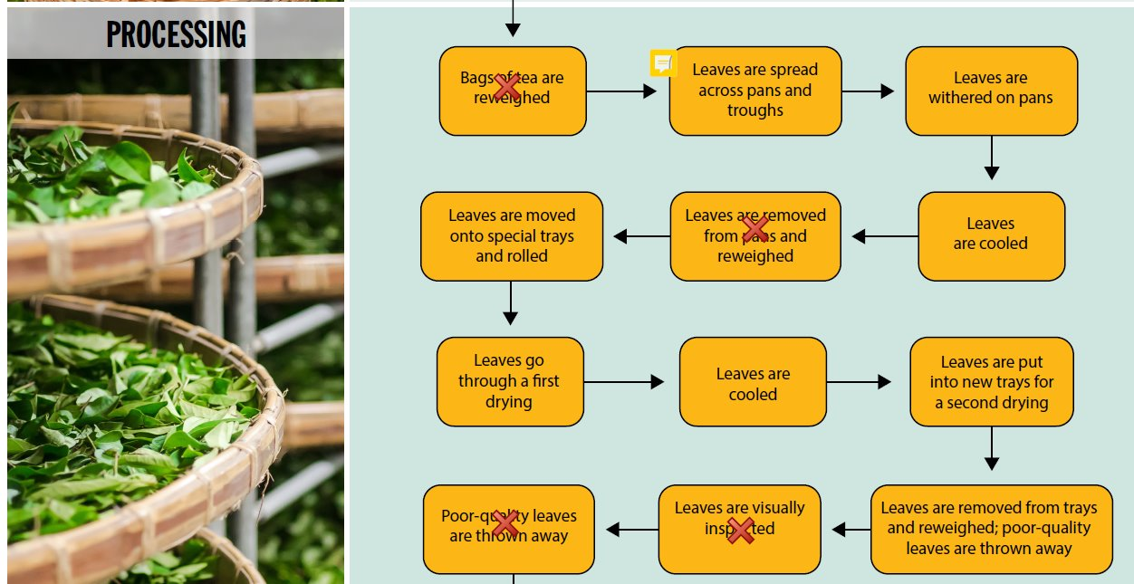
Lean Manufacturing – Processing
Steps to Remove:
Step 1 & 5: Reweigh bags
Not necessary since they already come in 50kg bags at the farm, they do not need to be weighed again here. They will be reweighed later in the process.
Steps 11 & 12: Inspect and Remove
Visually inspecting leaves and removing poor-quality leaves were already completed in Step 10 and will be done again in packaging.
Notes:
There appears to be a lot of unnecessary steps to weigh bags many times. If the bags come from the farm weighing 50 kg verified by the scales, there is no need for them to be weighed again upon arrival at the processing facility however, as mentioned, we should consider packing the bags on scales.
We can see from the red x’s on the process flow that there are processes that can be removed. I noticed a trend here that weighing and sorting happens far too often throughout the process. In the first sorting step, leaves are removed from trays and weighed with poor-quality leaves being removed, then the following steps are to visually inspect and throw away the poor-quality leaves which is redundant.
In step nine, leaves are transferred to new second trays. Depending on whether they are recyclable or there is a specific reason for moving leaves to a second pan for drying, this is an area where we can make an environmental and improved process impact. If the pans are recyclable and there is no specific reason for needing a new second pan, we can ensure we are using sustainable practices by using only one pan therefore saving the water and time it takes to wash second pans

Slide 13
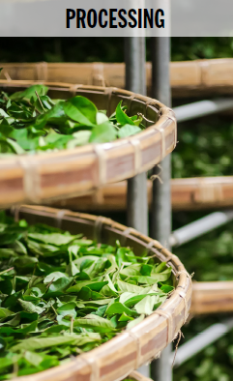
Updated Workflow in Processing
Leaves are spread across pans and troughs
Leaves are withered on pans
Leaves are cooled
Leaves are put into new trays for a second drying
Leaves are cooled
Leaves go through first drying
Leaves are moved onto special trays and rolled
Leaves are removed from trays and reweighed; poor-quality leaves are thrown away
Leaves are oxidized
Leaves are moved to an oxidizing area
Leaves are sent to packaging and shipping
Leaves get a final drying to complete the oxidation process
Leaves are cooled
Notes:
Shown here is the updated process with the steps that do not add value removed. This reflects the principles of lean manufacturing by eliminating processes that do not add value (Soomo, 2020).

Slide 14
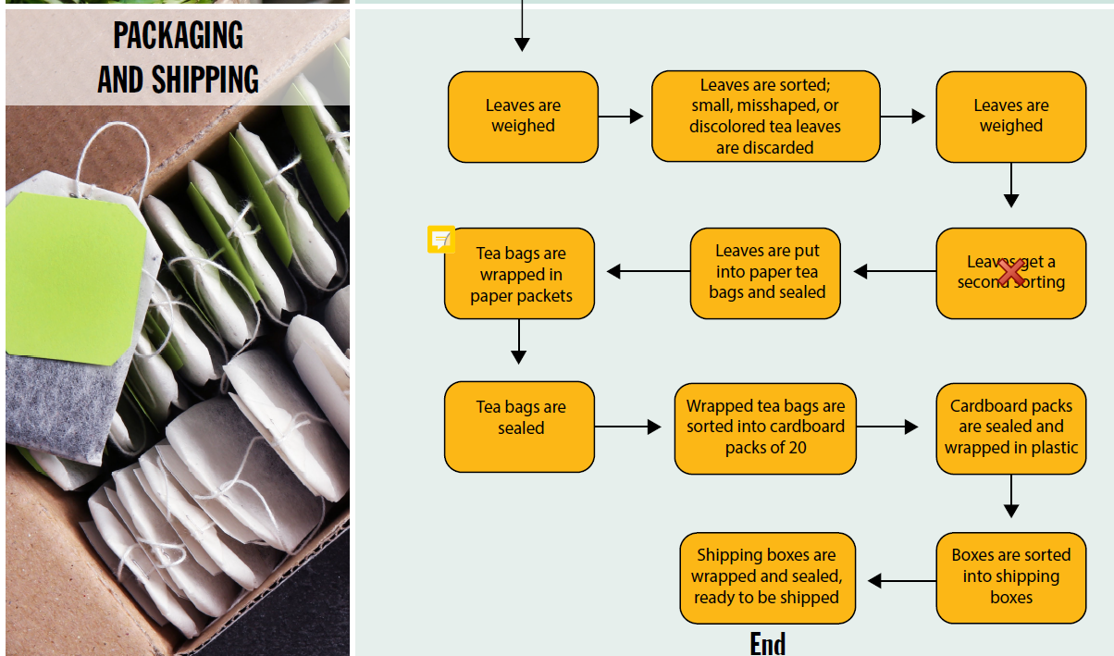
Lean Manufacturing Packaging and Shipping
Step to remove:
Step 4: Second sorting is not needed because they were sorted right before they were weighed and there was a previous sorting step as well
Additional strategies:
Use appropriate size shipping packaging to reduce waste and minimize shipping costs (Econocorp, n.d.).
Notes:
The second sorting in this stage is redundant because leaves were sorted and poor-quality leaves were removed in the last processing step and step two in packaging and shipping. Though quality is top of mind, we should monitor quality and adjust accordingly if it becomes a problem. You may notice there are two weights taken in this process. We will keep those to monitor production in processing and packaging and shipping. It will help us determine how much inventory we are losing to poor-quality leaves between the first and second sorting.
Additionally, in lean manufacturing, we can reduce waste and minimize costs in packaging and shipping (Econocorp, n.d.).

Slide 15
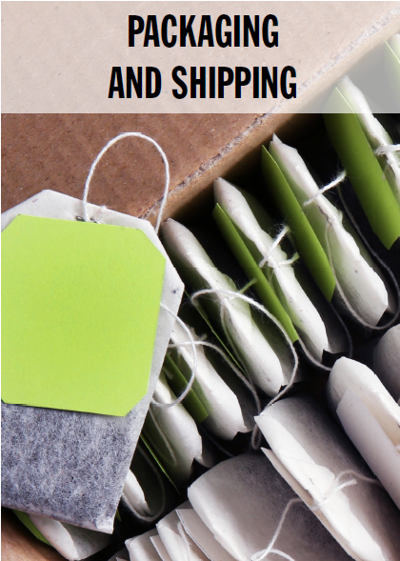
Updated Workflow in Packaging and Shipping
Leaves are weighed
Leaves are sorted; small, misshaped, or discolored tea leaves discarded
Leaves are weighed
Tea bags are wrapped in paper packets
Leaves are put into paper tea bags and sealed
Wrapped tea bags are sorted into cardboard packs of 20
Cardboard packs are sealed and wrapped in plastic
Tea bags are sealed
Shipping boxes are wrapped and sealed, ready to be shipped
Boxes are sorted into shipping boxes
Notes:
Shown here is the updated process for processing and shipping. Notice that there is one step removed, a sorting step, because they were sorted right before they were sent from processing to packaging and shipping. Packaging and shipping will weigh the bags, then go through a final sorting before leaves are weighed again for manufacturing and inventory metrics.

Slide 16
Benefits and Drawbacks of Changes in Workflow
Balancing these benefits with the need to maintain high product quality is essential to ensure that efficiency gains do not come at the expense of customer satisfaction and brand reputation.
Benefits
Implications of combining process at the Farm
Better control and monitoring of production
No additional cost as scales should already be onsite
Implications of removing extra weighing steps in Processing
Increased efficiency and cost-savings
Simplified workflow
Reduced bottlenecks
Improved focus
Implications of removing extra sorting
Increased efficiency and cost-savings
Simplified operations
Reduced waste
Improved flexibility to adapt to change
Drawbacks
Implications of combining processing at the Farm
Initial resistance to change from employees
Implications of removing extra weighing steps
Quality control risks
Regulatory compliance
Inaccurate data about yields
Potential for over or underfill
Implications or removing extra sorting
Quality Control Issues
Increased Customer Complaints
Employee layoffs
Notes:
There are many cost savings that are worthwhile but we should also consider and try to address the drawbacks. For instance, we will need to closely monitor quality. Rather than adding quality checks, we may need to revisit the process with the employees to help them better identify bad leaves.
We may experience initial push-back from employees, but I think if we explain that it will help them do their jobs faster, we will have a better change of having employees comply. If we were to pay bonuses based on individual performance, it could result in employees picking up the pace with an incentive to maximize productivity. That would be an additional cost, however, if production increases, we may still earn a higher profit. It is something to consider.

Slide 17
Process Changes - Alignment with Triple Bottom Line
Planet
Reduced resource usage
Decreased environmental
footprint
Lower waste production
Profit
Cost savings
Increased productivity and faster production schedules and this leads to increased revenue
Operational efficiency
Enhanced product consistency
People
Increased efficiency
Improved focus
Reduced task complexity
Higher productivity
Job statisfaction
Notes:
Lean manufacturing aligns with the triple bottom line because it drives growth based on efficiency, reduces waste, and saves money (Soomo, 2020).
In our business, lean manufacturing will help to decrease our environmental impact by making the manufacturing process more efficient thereby reducing waste. Keeping two sorting and quality checks ensures quality but eliminates the additional repeated quality steps that may not add value for more sustainability. This will require close monitoring. Additionally, if we implement a water reclamation program, we can further reduce resource usage.

Slide 18
Process Changes - Alignment with Triple Bottom Line
Profit
Cost savings
Increased productivity and faster production schedules and this leads to increased revenue
Operational efficiency
Enhanced product consistency
Planet
Reduced resource usage
Decreased environmental
footprint
Lower waste production
Reduced resource consumption
People
Increased efficiency
Improved focus
Reduced task complexity
Higher productivity
Job satisfaction
Notes:
If we operated under a single bottom line, we would only be interested in profit while the triple bottom uses increased margins to serve people better, care for the environment, and still make a profit and prioritize innovation (Soomo, 2020). This can result in increased efficiency, reduced waste, reduced costs, and increased profits.

Slide 19
Process Changes - Alignment with Triple Bottom Line
People
Increased efficiency
Improved focus
Reduced task complexity
Higher productivity
Job satisfaction
Profit
Cost savings
Increased productivity and faster production schedules and this leads to increased revenue
Operational efficiency
Enhanced product consistency
Planet
Reduced resource usage
Decreased environmental
footprint
Lower waste production
Reduced resource consumption
Notes:
Investing in people, primarily employees, could arguably be the most important sustainability initiative. When employees are happy, they are more likely to make the effort to do the best job they can. This increases sales and profits which can then be reinvested into initiatives that benefit our employees.

Slide 20
Process Changes - Alignment with Triple Bottom Line
Planet
Reduced resource usage
Decreased environmental
footprint
Lower waste production
Reduced resource consumption
People
Increased efficiency
Improved focus
Reduced task complexity
Higher productivity
Job satisfaction
Profit
Cost savings
Increased productivity and faster production schedules and this leads to increased revenue
Operational efficiency
Enhanced product consistency
Notes:
All three factors must be present in the triple bottom line which contributes to our efforts to improve our sustainability. This will be critical when we are assessed for B Corp certification.

Slide 21
Issue Log Item 1
There is general confusion among stakeholders regarding their level of decision-making power, involvement, and scheduling of major project milestones.
Recommendations:
Update charter to clearly define roles and decision-making.
Create a clear communication plan with updates.
Use scheduling tools to track milestones and responsibilities
Hold training sessions to review roles
ThePhoto by PhotoAuthor is licensed under CCYYSA.
Notes:
It is essential to clarify roles and responsibilities in the project charter. The confusion affects the initiating, planning, communication, and resource allocation, leading to potential delays and inefficiencies (Soomo, 2020). To solve this, the project manager should update the project charter, create a clear communication plan with regular updates, and use scheduling tools to track milestones and responsibilities. Training sessions can also help stakeholders understand their roles better, ensuring smoother project progress.

Slide 22
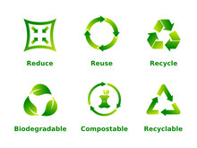
Issue Log Item 2
​
A stakeholder has recommended a change from the existing product packaging to shiny foil packaging for aesthetic reasons, and they have asked for this built into the process workflow documents. ​
​
Effects of this change:
More expensive
Change production timelines
Not biodegradable
Recommendation
Invest in finding the most sustainable packaging available that is either biodegradable or recyclable. The ideal would be biodegradable where the customer is not expected to recycle.
As mentioned, foil is not biodegradable or recyclable, so it does not meet our standards.
Notes:
It is important to evaluate the impact on the project. This change affects the process workflow documents and could alter costs, production timelines, and environmental considerations. To address this, the project manager should assess the feasibility of the change, including budget implications and sustainability impacts. If feasible, the workflow documents need to be updated to incorporate the new packaging process. Clear communication with all stakeholders is essential to ensure understanding and agreement on the changes, keeping the project aligned with its goals and timelines.
I’d also like to emphasize that to keep with our sustainability standards, foil packaging is not recommended. Did you know that it is not biodegradable, and takes over 100 years to break down, and not eco-friendly. I think we should focus on sustainable packaging and invest in finding the highest quality packaging at a reasonable cost and see if we can eliminate some of our packaging. Currently, teabags are sealed in paper bags, then they go into cardboard boxes, followed by plastic wrap. The plastic wrap is also not biodegradable or recyclable so if we can find a way to package it safely without the plastic wrapping, that would be ideal.

Slide 23
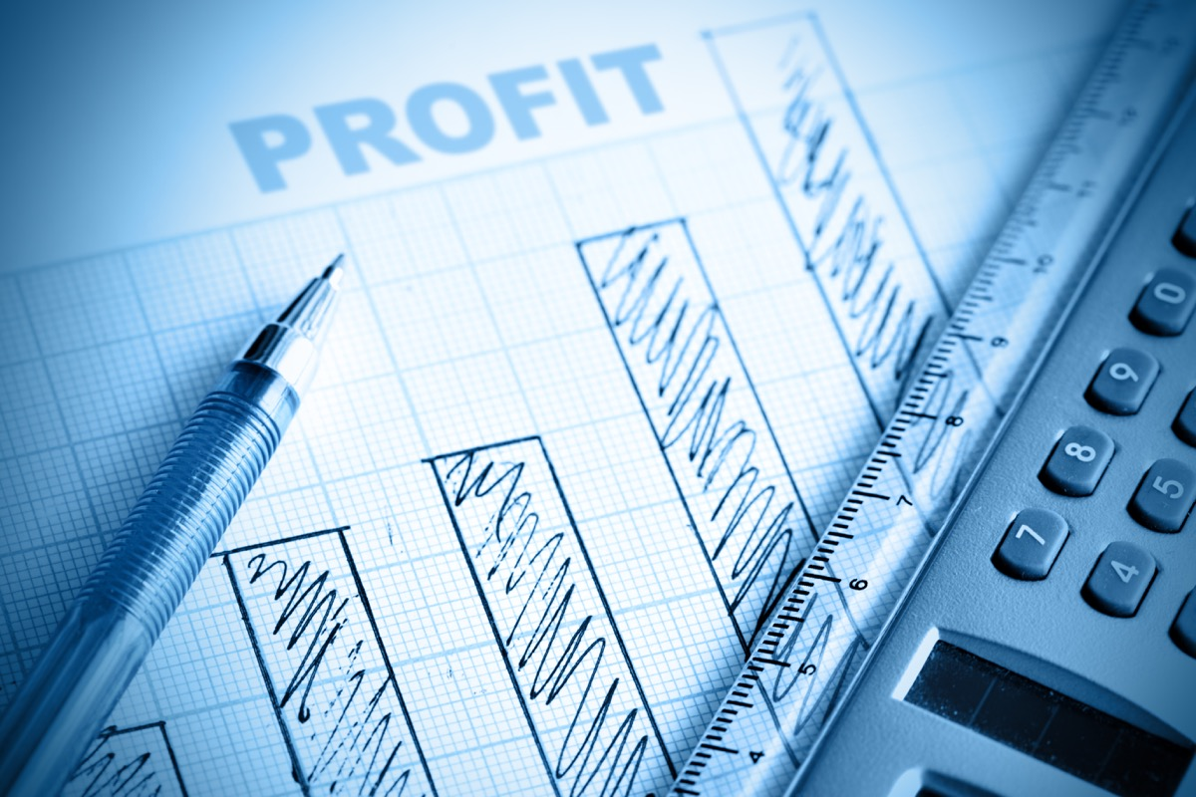
Issue Log Item 3
The procurement department wants to triple the project budget to allocate more funds to researching, testing, and finding a new supplier for compostable packaging materials.
.
Recommendations​
Move forward with the new budget for research, testing, and finding a new supplier for compostable packaging.
Contract with a third party
Research grants and subsidies
Analyze the feasibility of eliminating some packaging to save costs.
Consider investing in renewable energy sources such as solar panels and take advantage of government subsidies and grants for research and testing to offset our costs.
ThePhoto by PhotoAuthor is licensed under CCYYSA.
Notes:
This significant budget increase impacts the project's financial scope and may affect other project areas. The project manager should evaluate the necessity and benefits of switching to compostable materials, considering long-term sustainability goals and potential cost savings. If the budget increase is justified, the project plan and budget need adjustments, and clear communication with stakeholders is required to ensure alignment and manage expectations regarding project outcomes and timelines.

Slide 24
References
Econocorp. (nd.d). Packaging efficiency and lean manufacturing: Strategies for success. https://www.econocorp.com/packaging-efficiency-and-
lean-manufacturing-strategies-for
success/#:~:text=Utilizing%20packaging%20that%20is%20appropriately,expenses%20due%20to%20volumetric%20considerations.
National Institute of Food and Agriculture. (n.d.). Sustainable agriculture programs.
https://www.nifa.usda.gov/grants/programs/sustainable-agriculture-programs
PrintOnPack.com. (n.d.). The pros and cons of using foil packaging materials. https://www.printonpack.com/blog/the-pros-and-
cons-of-using-foil-packaging-materials/#:~:text=2.
-,Environmental%20Impact,negative%20impact%20on%20the%20environment.
Ragany, M., Haggag, M. El-Dakhakhni, W., Zhao, B. (2023, March 4). Closed-loop agriculture systems meta-research using
text mining. Department of Civil Engineering, McMaster University, Hamilton, ON, Canada.
https://www.frontiersin.org/journals/sustainable-food-systems/articles/10.3389/fsufs.2023.1074419/full

Slide 25
Soomo. (2020). People, planet, and profit. https://www.webtexts.com
Supply Chain Solutions. (n.d.). Packaging waste 101: the solutions.
https://supplychain.edf.org/resources/sustainability-101-packaging-waste-solutions/
TeaLeaves. (n.d.).Discover the perfect pairing of tea and nature | Repurposing your tea
leaves. https://www.tealeaves.com/blogs/explore-our-teas/tea-and-your- garden#:~:text=Not%20only%20are%20they%20good,the%20use%20of%20harsh%20chemicals!
UCLA. (n.d.). Sustainability is the balance between the environment, equity, and economy. https://www.sustain.ucla.edu/what-is- sustainability/#:~:text=Sustainability%20presumes%20that%20resources%20are,world%20we%20 will%20leave%20them.
Xiangfei Yang, Gu Du, & Mengna Li. (2019). Environmental study of purchasing strategy
based on supply disruption via option contracts for agricultural supply chain. Ekoloji
Dergisi, 107, 4697–4704. https://eds-p-ebscohost-
com.ezproxy.snhu.edu/eds/pdfviewer/pdfviewer?vid=4&sid=d3812efd-638a-4c2b-
90f9-7069cbfe26d6%40redis

